Slide 1


VIRTUAL INTELLIGENCE SERVICE
VICTORIA PER INTELLECTUM
TITLE
INTSUM VIS-XX-XXX
DISCLAIMER:
This is for multiplayer online gaming using the Digital Combat Systems simulation software published by Eagle Dynamics. The information is not in any way suitable for real world use or operations.
Version: X.X
Published: YYYY-MM-DD

Slide 2
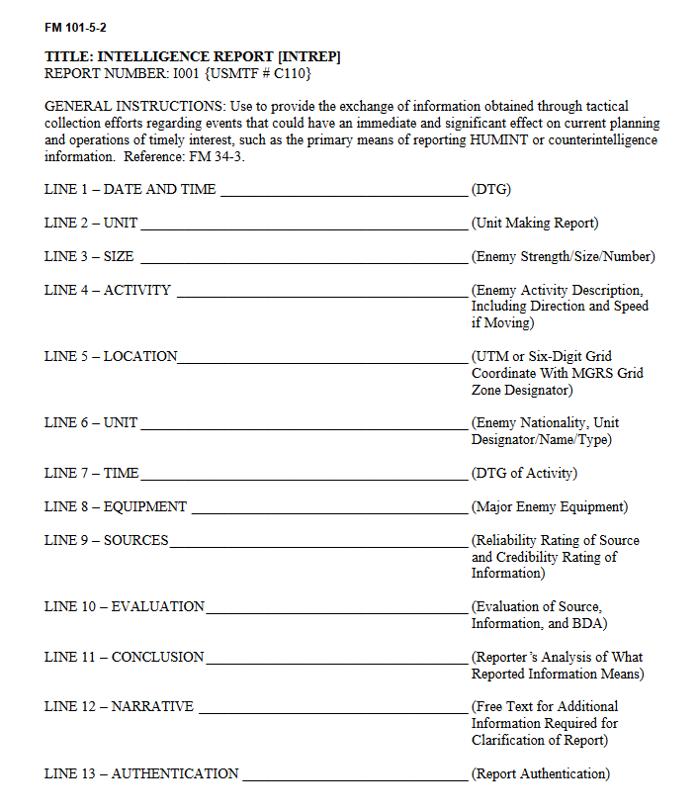
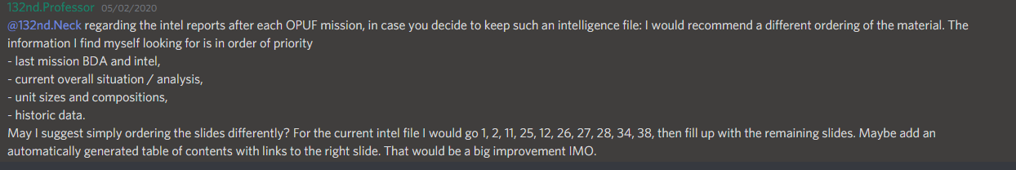
Information
Who:
What:
Where
When:
How:
Assessment
Conclusion
INFORMATION
ASSESSMENT
CONCLUSION
TO BE DECIDED

Slide 3
